Slide 1

Predix Hackathon
PERFORMANCE MANAGEMENT VIA LOW COST SENSOR
Final Presentation

Slide 2
Presentation Content
Hackathon TEAM;
Project Goal;
Project Concept;
System Components;
Network Reference Diagram;
Project Results;
The low cost Hardware
Cloud Dashboard
Examples for Real Application;
Next Steps.

Slide 3










Hackathon TEAM
Giorgio Chivilo
Project Manager
Genoa - Italy
Bartosz Sylwester
Lead Technical Specialist
Poland
Nicolandrea Costa
Lead Technical Specialist
Genoa - Italy
Vamsi Kasturi
Technical Specialist
Frankfurt - Germany
Gisella Bennardo
Technical Specialist
Genoa - Italy
Daniel Batista
Systems Engineer
Sao Paulo - Brazil
Miroslav Pindjak
Lead Technical Specialist
Genoa - Italy
Carlos da Rocha
Systems Engineer
Sao Paulo - Brazil
Alberto Gorni
Lead Technical Specialist
Genoa - Italy
Luca Guccione
Project Engineer IDI
Genoa - Italy
Development Team
Support Team

Slide 4





Project Goal
We have Tons of Low cost sensors device in the world.
The Wifi connection is cheap.
Is it really needed to use expensive device to collect data?
Can we use Low Cost sensor for Industrial Application?

Slide 5
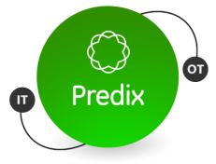
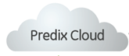

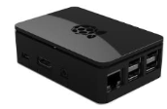


Project Concept
EDGE Predix Machine Connecting Low Cost Devices, in a easy way to the Predix Cloud
Low Cost solution <$100
Raspberry Pi
$50
Predix Machine
Wifi Network
Sensors
$5 each
Others kind of devices
Can Also be connected !
Once inside Network
Low Cost Sensor

Slide 6
System Components

Slide 7
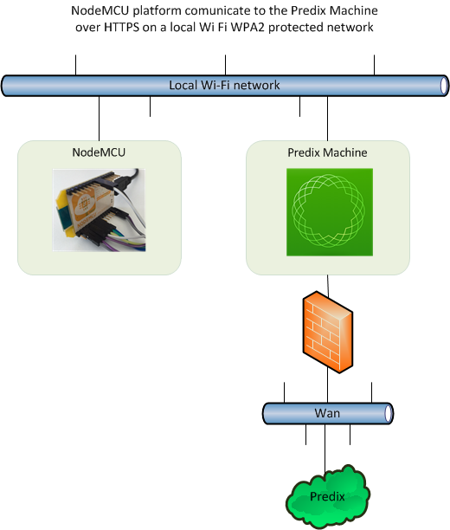
Network Reference Diagram

Slide 8
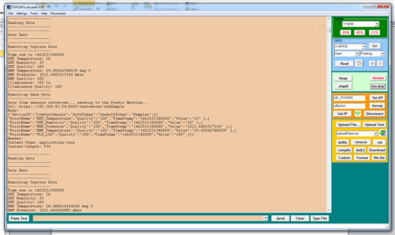
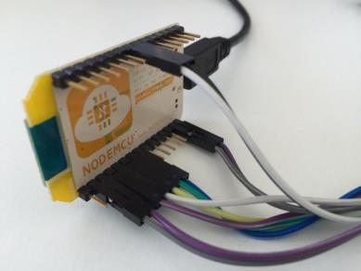
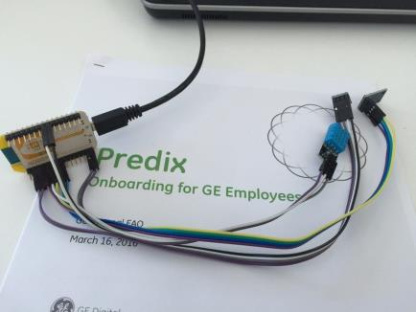
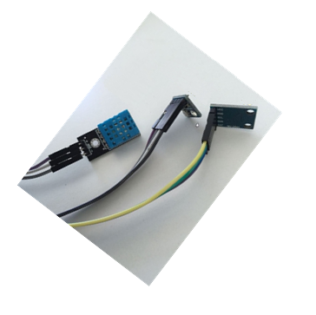
The low cost Hardware
5$
1$

Slide 9
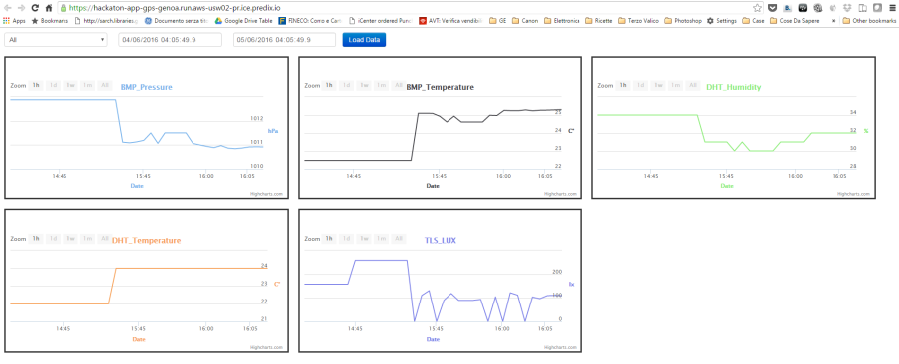
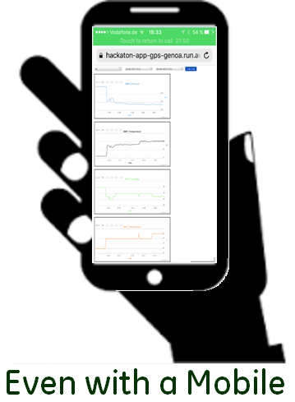
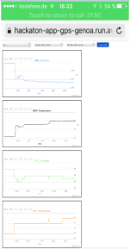
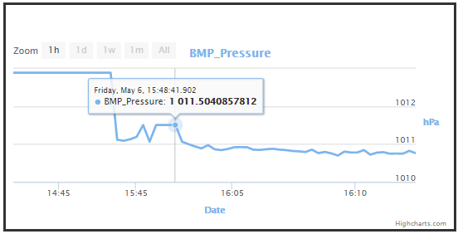
Cloud Dashboard
https://hackaton-app-gps-genoa.run.aws-usw02-pr.ice.predix.io/

Slide 10
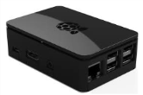






Examples for Real Application - I
Predix Machine
Healthy workstation
Low Cost HTTP sensors placed in the workstation environment, collecting and sending relevant measures to Predix Machine about employee work condition (Lighting, Humidity, Mood, temperature, etc…).
Predix using Repository and Analytics, provide Workforce Performance Report in web format and/or Smatphone Apps.
WORKFORCE PERFORMANCE
MANAGEMENT REPORTS

Slide 11




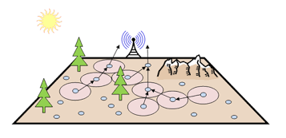


Examples for Real Application - II
Agricultural Performance Management
Low Cost HTTP sensors placed on the plantation area, collecting and sending relevant measures to Predix Machine about crop condition (Sun/Rain Intensity, air & earth Humidity , Irrigation performance, Temperature, etc…).
Predix Machine
Predix provides Reports and advices to improve the quality of crop season and also Forecasted information about the Farm Perfomance.
CROP SEASON PERFORMANCE
MANAGEMENT REPORTS

Slide 12
Next Steps
Implement security layer;
Sensor subscription – Sensor Registering;
Transform in a framework;
Implement write command from Predix Cloud;
Implement Automatic Scaleability of Predix Machine (Webservice and adapter).

